Slide 1
Managing Stormwater Service Requests from Citizens

Slide 2
Why do we respond?
The citizens of Mecklenburg County are our customers
Providing quality service to our customers is the most important thing we do
The perception of Mecklenburg County government is formed through these interactions
Citizens are our best resource for finding pollution problems

Slide 3
Receiving Requests for Service
Call us - 311
Web request – via computer
Water Watchers App – via smartphone
Directly – in the field
From another agency
Emergency & After Hours – ER phone

Slide 4
Routing Requests
311 operators use key words to assist with routing to the correct agency
Occasional re-routes needed
Web and Water Watchers requests are sent to all supervisors for review

Slide 5
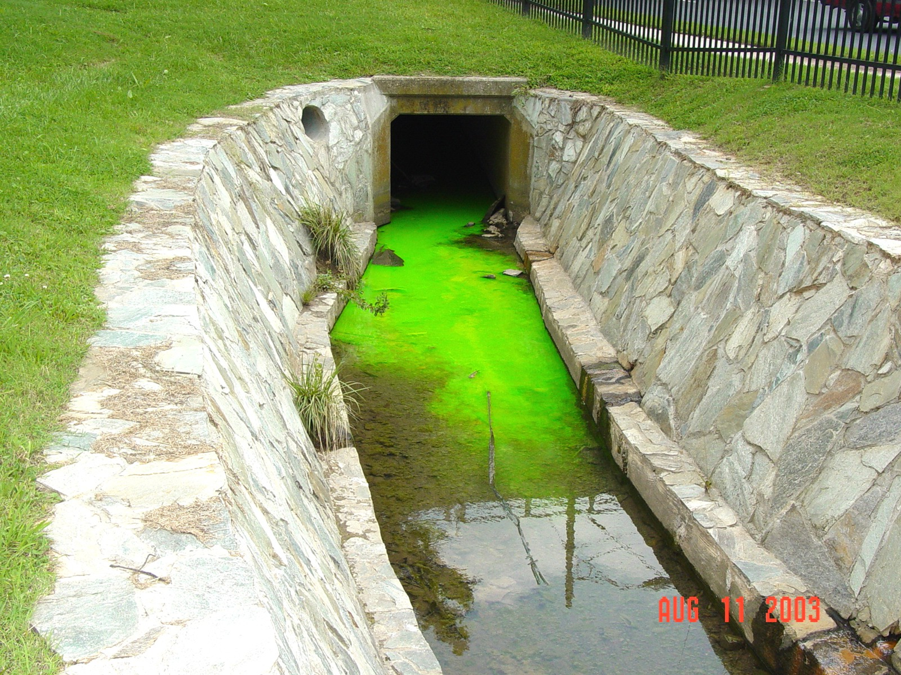
Prioritizing Requests
By Threat Level
Type I – Health/Safety Threat
Spills to swimming areas, water intakes, playgrounds
Type II – Spill/Illicit Discharge
SSOs, saddle tank rupture, active violation
Type III – Non emergency request for assistance/information
Possible buffer violation, non active minor violation

Slide 6
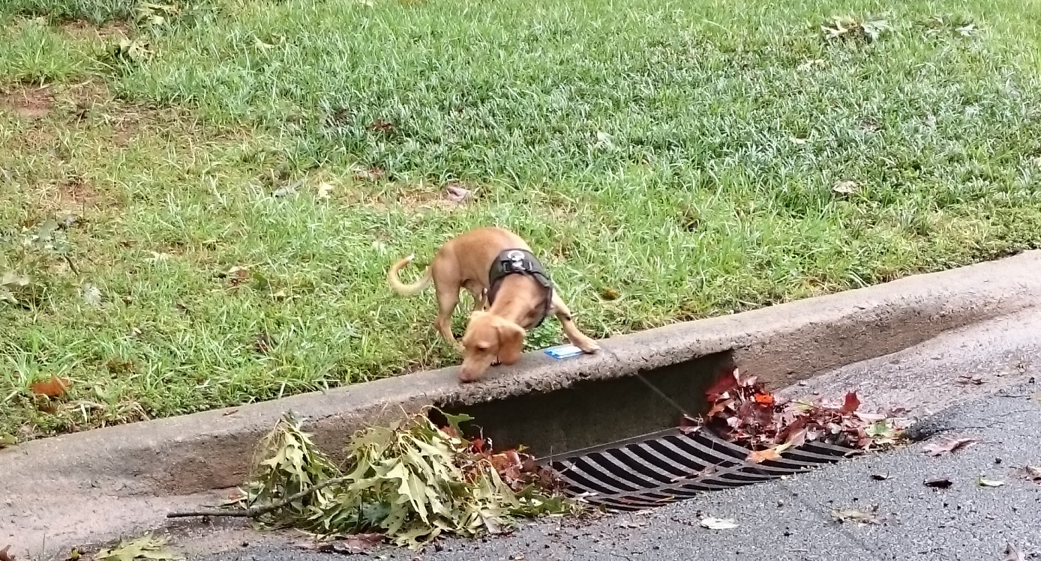
Service Request Response
Contact the customer & Provide your business card
Ask the customer what you can do to help.
Identify the source of the problem
Notify the customer of the findings
Issue Notices of Violation (if needed)
Notes:
Contact the customer and identify yourself as being with Charlotte-Mecklenburg Storm Water Services’ Water Quality Program. If contact is made with the customer in the field, provide them with a business card. If this contact is not made, leave a business card in the front door of the customer’s residence.
Ask the customer what you can do to help. Always treat the customer with courtesy and respect. Maintain good eye contact when communicating with the customer, have a positive attitude and use good body language.
Identify the source of the problem/concern and take necessary actions to evaluate water quality impacts. Involve additional agencies and your supervisor as necessary. Ensure the health and safety of Mecklenburg County citizens and staff in all your actions.
Contact the customer within two (2) business day of detection of the source of the problem/concern and notify them of your findings and the specific actions that will be taken regarding their problem/concern as well as the schedule for completion of these actions. Very clearly address your and their expectations.
Issue Notices of Violations as necessary and within two (2) business days of detection of violation.

Slide 7
Service Request Response
Conduct follow ups to ensure compliance
Follow up with the customer at completion of request
Notes:
Conduct follow up actions on or before the specified compliance date in the notice of violation to ensure that pollution problems are quickly and effectively corrected. Evaluate water quality to ensure that all negative impacts have been adequately addressed.
Contact the customer within two (2) business day following the resolution of the problem and notify them of the final disposition. Ask the customer if they are satisfied with the service provided and if they are not find out why and address as necessary. Notify the customer that they will receive a Customer Service Questionnaire in the mail along with a postage paid return envelope. Encourage them to respond.
Follow all additional Mecklenburg County and Water Quality Program Procedures when applicable, such as the Sampling Protocol Manual, Sewer Spill Response Procedures, IDDE Manual, and Notice of Violation Tracking Procedures.

Slide 8
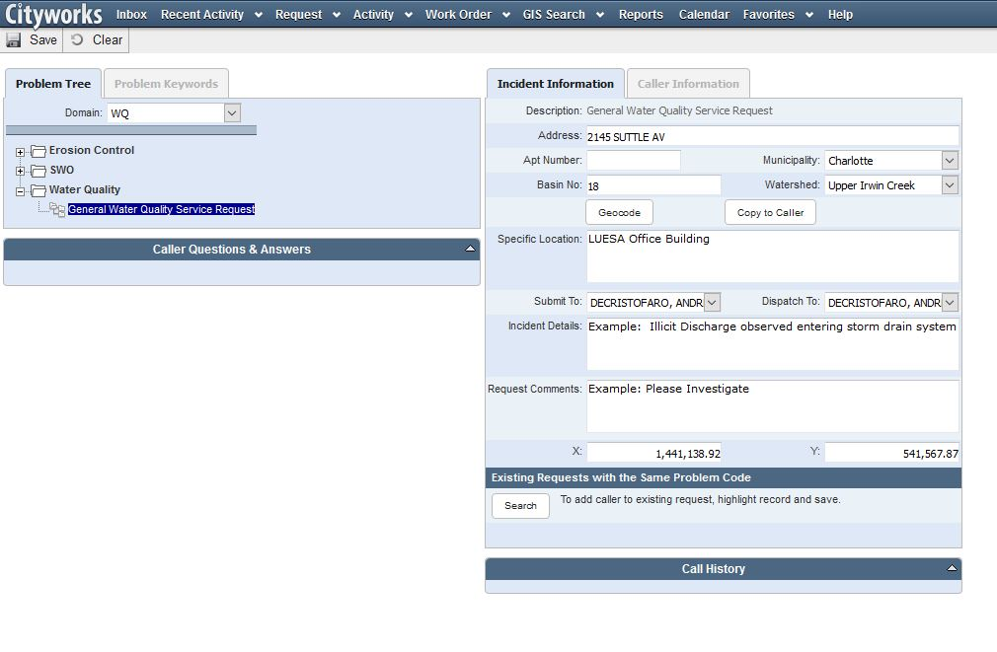
Documenting Requests
In CityWorks

Slide 9
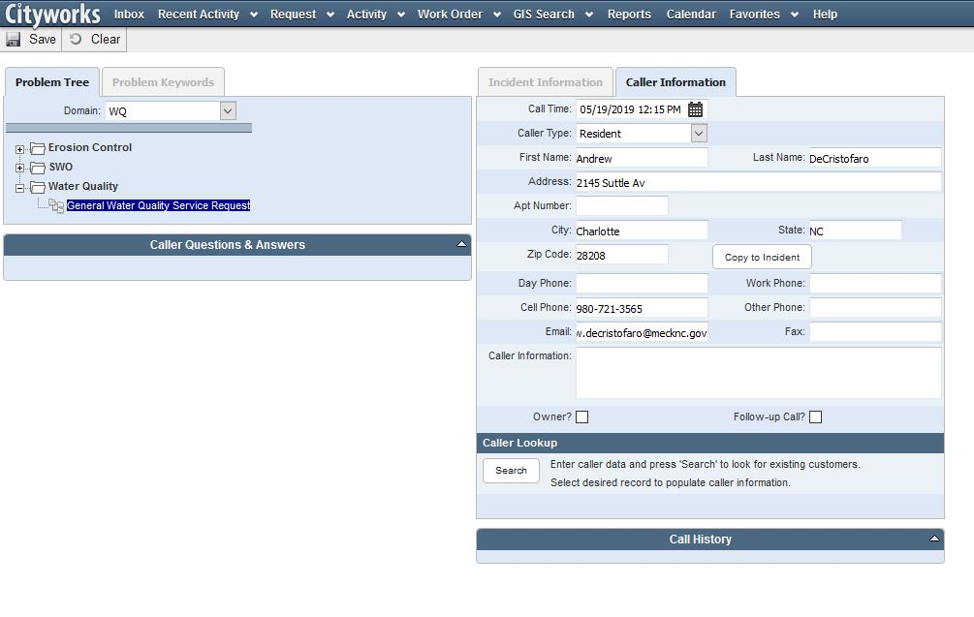
Documenting Requests
In CityWorks

Slide 10
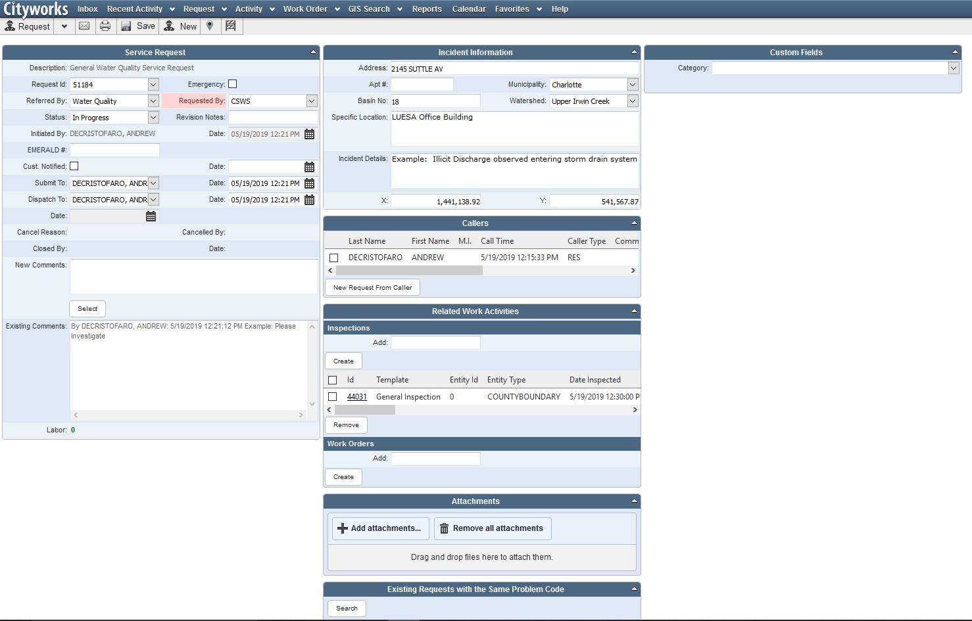
Documenting Requests
In CityWorks

Slide 11
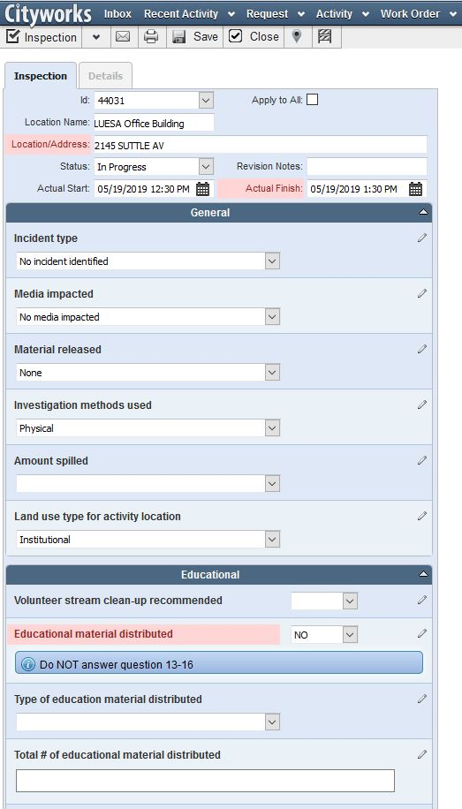
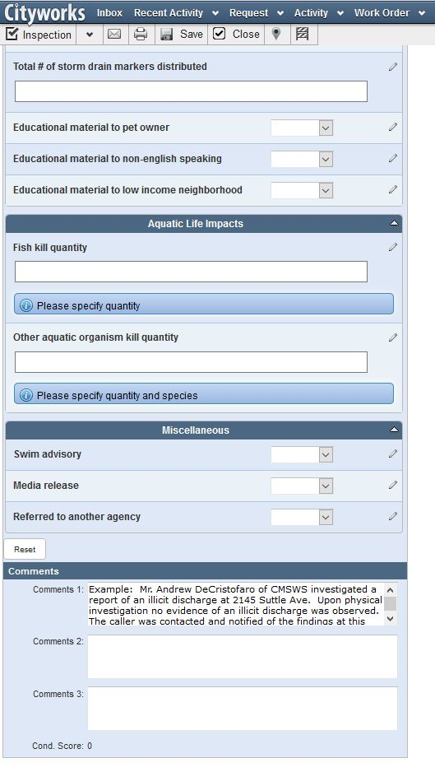
Documenting Requests
In CityWorks

Slide 12
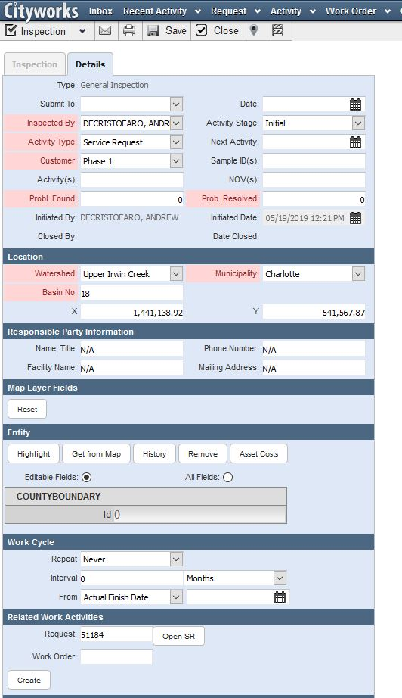
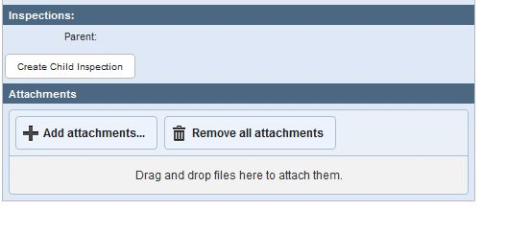
Documenting Requests
In CityWorks

Slide 13
Reporting
Charlotte NPDES MS4 Program Field Investigations, Service Requests, and Emergency Response FY2018 Program Summary
Number of Service Requests 1994 - 2018 | 11,563
Number of Service Requests FY2018 | 519
Service Request Type | Accidental Spill – 49 Algae Bloom – 6 Fish Kill – 3 Discharge/Dumping – 232 Buffer Disturbance – 1 Erosion – 12 Illicit Connection – 7 No Incident Identified - 104 Unspecified/Other – 76 Natural Condition – 19 Monitoring Follow-up - 1 Unknown - 10
Service Request – Material Type | Chemical – 5 Concrete – 12 Cooking Oil – 13 Automotive Fluids – 47 Paint – 7 Sediment – 18 Sewage – 76 Trash – 29 Wastewater/Wash Water - 3 Yard Waste – 10 Other/Unknown – 74 None/Natural Conditions – 174 Allowable Discharge – 16 Pet Waste -2
Number of Follow-up Field Inspections | 440
Emergency Responses during FY2018 | 31
No. of SSOs found through service requests | 76
NOVs Issued under IC-F(1) | 91
Staff Trained – Service Requests | 26
Staff Trained – Emergency Response | 26
Staff Trained - IDDE | 26
Number of Outfalls Inspected under IC-F(1) | 5

Slide 14
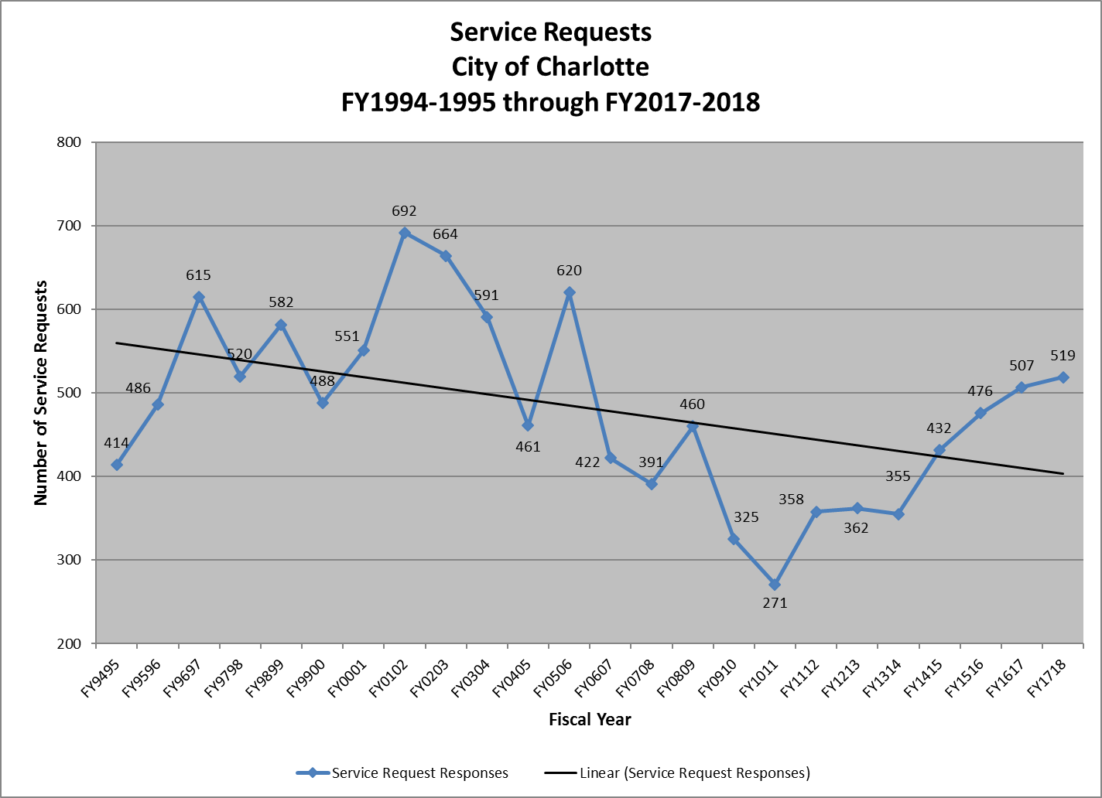
Reporting

Slide 15
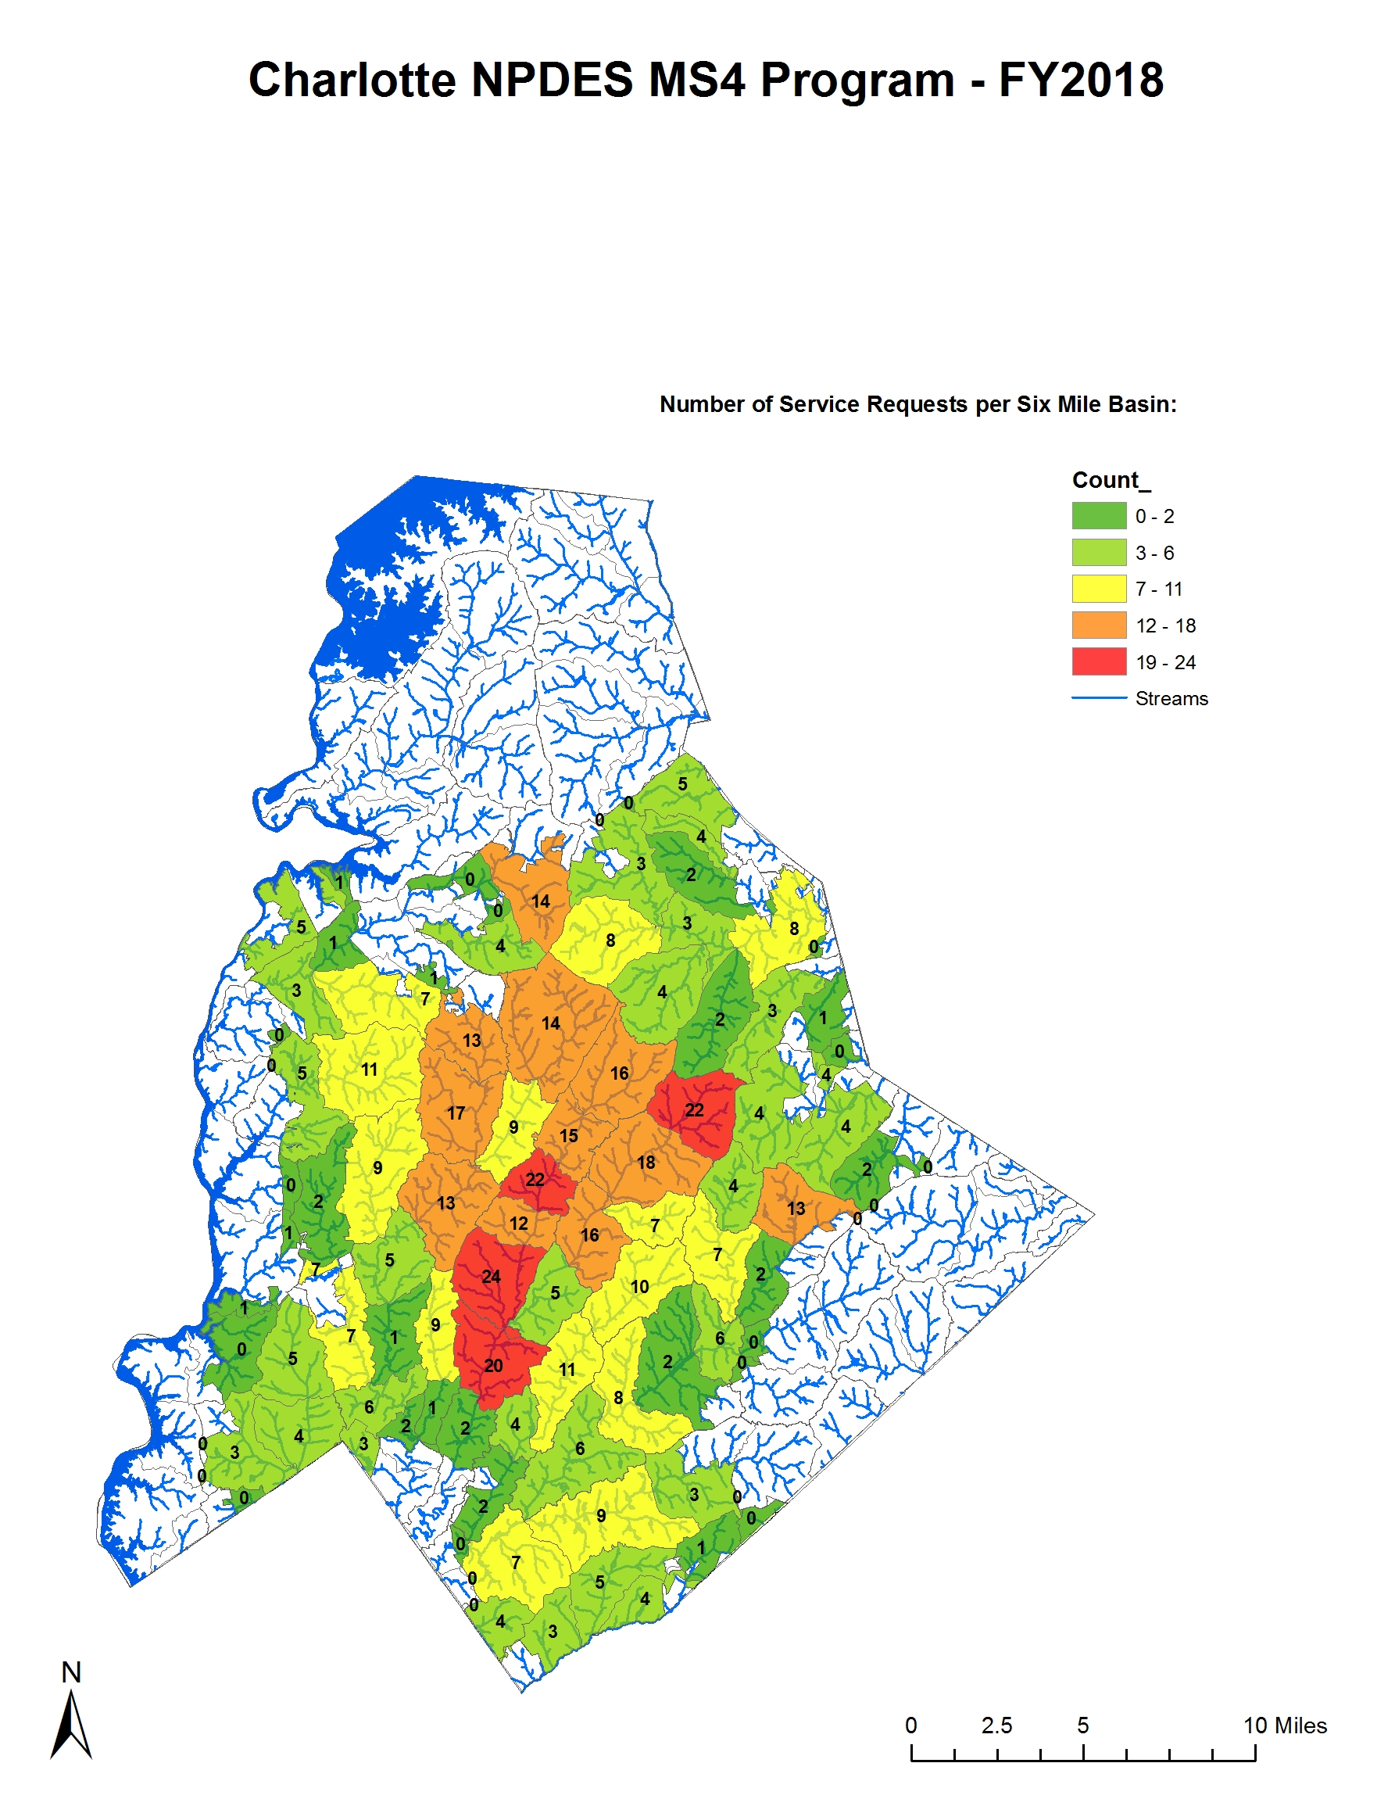
Reporting

Slide 16
Thank You.
Andrew DeCristofaro
980 721 3565
Andrew.DeCristofaro@MeckNC.gov
StormWater.CharMeck.org

